Slide 1


Slide 2

Welcome to Year 4 - Bee class!
Mr. Christofa (Class Teacher)
Mrs. Lawry (Class Teacher- Thurs mornings)
Mrs Kendall (LSA- Mornings)
Mrs Greenwood (LSA- Afternoons)
Thank you for coming this afternoon

Slide 3
Mr Christofa
Been teaching for 11+ years
Been at Langrish for 2 years, but taught in a variety of contexts and demographics
I live in Havant with my partner, dog and cat
Separate to my job as a teacher, I am also the subject lead of English and PSHE, I lead the school parliament (including running four of the school parliament groups) and I am the Deputy Head teacher, so lots of responsibilities!

Slide 4
My classroom ethos
We will treat every child as if they are the next Einstein - all children are BRILLIANT at something
In Education, we give children knowledge as well as teach how to learn (give them the skills)
We believe in children having self-confidence and knowing what to do when does build confidence
Our class learning behaviours have been chosen and are up on display, have a look now…
Reading is the most crucial part of education; “being fuctionally literate is one of the greatest gifts we can provide for our children, as it not only opens up other areas of the curriculum - the rich tapestries of stories that make up the other subjects – it also provides a vast number of opportunities for them”. Having a joy of reading in primary school is used to measure a child’s success in future life.
We have a lot to cover this year – our days will have a high pace and children encouraged to use their time wisely e.g. I tell them that if they are sat there doing nothing or just chatting then it makes me anxious and there’s something they should be doing – from reading quietly, practicing spelling, learning times tables, completing their reading record, to name a few….. There are plenty of times for chatting – in lessons (directed), paired work etc, but there is a distinction between play time - a chance to run about with your friends, run around, chat about your weekends, eat snacks etc and lesson time.
Going to the toilet – This should only be happening at break tine and lunch time because learning is crucial

Slide 5
What to bring to school:
Pencil case (sensible size - no suitcases!) with sharp pencils (no clicking pencil pens), blue writing pen (if you have a pen licence), 2 whiteboard pens (they run out fast), rubber, sharpener that catches sharpenings, ruler, selection of colouring pencils, red pen, highlighter and a glue stick.
School bag - not too large (our cloakroom is small!)
Waterproof coat (when needed)
Reading record & book they are reading
Water bottle – not metal and one that doesn’t leak easily
Welly boots - we will let you know when they are needed (see class webpage for updates)

Slide 6
What to expect from Year 4
Class web-page will be added to every week, and I will set home learning, include updates of learning from that week in school, and updates on dates coming up. There are also useful links to websites and letters e.g. curriculum newsletter for each half term.
Home learning – House points will be given to those who complete homework. I will be checking who does them and will celebrate this in class.
Your child should read for 20-30 minutes per day at home - they can record their books in the reading records - but individual page numbers do NOT need to be recorded (this is different from Year 3), we suggest using a bookmark to 'save the page'. For 'free readers': once a book is completed a 'Blooms' question should be answered in the 'comments' box. Please check this has been done on a weekly basis. The same high standards are expected e.g use a pen or pencil, words should be spelt correctly and capitals for names and new sentences.

Slide 7

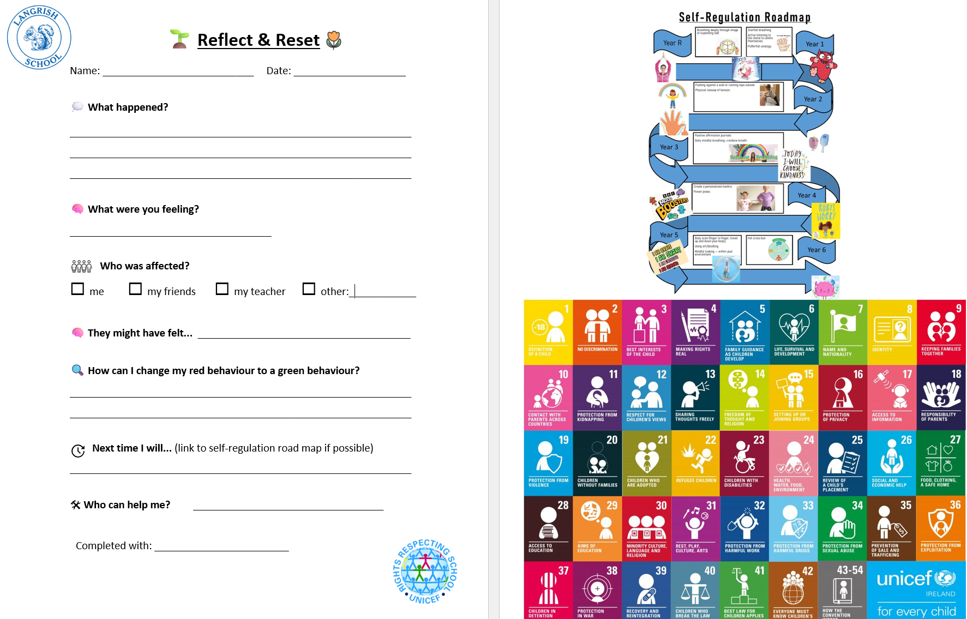
Restorative Conversations
Last year, our School Council reviewed some of our school language to ensure it reflects our revised behaviour policy. We believe that the words we use matter. They can shape how children view themselves, their learning and their mistakes.
Our approach focuses on:
✅ Person-centred language that sees the child before the behaviour
✅ Blameless conversations that focus on understanding and improvement
✅ Accurate and respectful terminology that values every member of our community
✅ A growth mindset, recognising that mistakes are opportunities to learn
For example, "Reflection Sheets" have evolved to "Reflect & Reset”, which may be used collaboratively to support and capture restorative conversations. When appropriate, the outcome of these conversations may be a social story to support the individual instead. This change helps emphasise that the process is about learning, repairing and moving forward, rather than punishment.
Our aim is simple: to help every child feel respected, supported and empowered to make positive choices.

Slide 8


Internet Safety & Screen Time Considerations
As technology continues to evolve, helping children navigate the online world safely remains a key priority for our school.
This year and beyond, we will continue to:
Promote a smartphone-free childhood, encouraging children to engage, play and connect away from screens wherever possible. This includes ensuring screen free alternatives to home learning and considering how and when smart boards are used in classrooms. No smartphones are permitted on site for children; this is in-line with our local secondary school’s policy.
Teach children about Artificial Intelligence (AI), helping them understand both its opportunities and potential risks, and how to use emerging technologies responsibly.
Develop online safety knowledge and skills through our curriculum, equipping pupils to make informed and safe choices online.
Work in partnership with families to ensure children receive consistent messages about online safety at school and at home.
New for September - Online Safety Corner
Rather than sending occasional online safety newsletters, from September we will be launching a dedicated Online Safety Corner on our Nutshell to:
Up-to-date guidance and resources
Information about emerging online trends and risks
Practical tips for supporting children at home
Updates on what pupils are learning in school
"Technology will continue to change. Our commitment to helping children use it safely, responsibly and confidently will not."

Slide 9

At every stage of a child's journey, we want pupils to feel valued, motivated and proud of their achievements. As children grow, the way we
recognise success develops too, reflecting their increasing maturity and helping them build aspiration and resilience. However, this year we
wanted to do things slightly differently to ensure we support our pupils in the best way possible.
Going forward, we are going to celebrate across the school like this:
Year R & Key Stage 1
We celebrate a wide range of achievements and aim to ensure every child has opportunities to be recognised throughout the year.
This helps to build confidence, belonging and a love of learning.
Key Stage 2
As pupils mature, Celebration Assembly becomes a more prestigious recognition.
Awards are given to those who have demonstrated exceptional achievement, effort, improvement or contribution linked to our values of ambition, belonging and curiosity. Not all pupils will be celebrated every year.
This helps children to develop determination, resilience and pride in working towards a meaningful goal.
At secondary school, pupils are not celebrated quite as much as in primary schools, and we want to support our pupils to ease into this transition
As children move through the school, our approach to celebration evolves alongside them. In the early years, we focus on building confidence by ensuring every child
experiences recognition and success. By Key Stage 2, celebration becomes more selective, recognising those who have demonstrated exceptional effort, achievement
or personal growth. This balance allows all pupils to feel valued while encouraging them to aspire to excellence.

Slide 10
Any questions?

