Slide 1

Year 2 Deer Class
Meet the Teacher

Slide 2

Our Year 2 Team
Mrs Wood Monday to Thursday
Mrs Rawlings Friday
Miss Rhodes Tuesday to Thursday

Slide 3
What do the children need?
Clear plastic water bottle
Reading wallet (all will receive new folders soon ☺)
Old shirt for art (named please)
Snack
  optional
  fresh fruit or vegetable please, nothing in a wrapper

Slide 4
Year 2 Non-Negotiables
Found in your child’s reading record
Key elements of the Year 2 Curriculum
Front of the reading record are all both log in’s for purple mash and ed shed.

Slide 5
Reading Records
Please read daily (10-15 mins) with your children
School reading book
Log this in your reading record
  A short, learning driven comment
  Can be just a page number and initial
Checked weekly (Friday)
New Autumn reading challenge

Slide 6
Reading in school
Guided reading daily with the teacher adapted to ability.
Reading in lessons daily (mixed with other subjects; writing, history and geography.
Children are encouraged to change their reading books independently (could be daily)

Slide 7
Home Learning
Spelling shed (different spelling sound each week)
Attached to the webpage will be the spellings to complete on paper if you wish
Short maths games (online or playing games at home)
Signposted each week on the website

Slide 8
E-Safety
Parental controls
Keep talking
Supervised use – even as their confidence grows!

Slide 9


Internet Safety & Screen Time Considerations
As technology continues to evolve, helping children navigate the online world safely remains a key priority for our school.
This year and beyond, we will continue to:
Promote a smartphone-free childhood, encouraging children to engage, play and connect away from screens wherever possible. This includes ensuring screen free alternatives to home learning and considering how and when smart boards are used in classrooms. No smartphones are permitted on site for children; this is in-line with our local secondary school’s policy.
Teach children about Artificial Intelligence (AI), helping them understand both its opportunities and potential risks, and how to use emerging technologies responsibly.
Develop online safety knowledge and skills through our curriculum, equipping pupils to make informed and safe choices online.
Work in partnership with families to ensure children receive consistent messages about online safety at school and at home.
New for September - Online Safety Corner
Rather than sending occasional online safety newsletters, from September we will be launching a dedicated Online Safety Corner on our Nutshell to:
Up-to-date guidance and resources
Information about emerging online trends and risks
Practical tips for supporting children at home
Updates on what pupils are learning in school
"Technology will continue to change. Our commitment to helping children use it safely, responsibly and confidently will not."

Slide 10
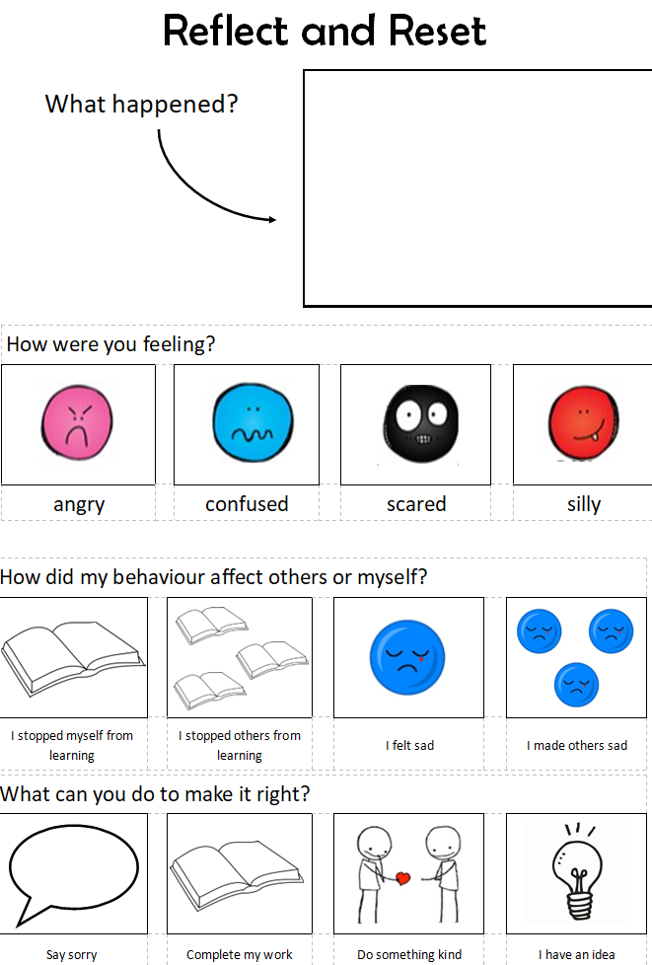
Restorative Conversations
Last year, our School Council reviewed some of our school language to ensure it reflects our revised behaviour policy. We believe that the words we use matter. They can shape how children view themselves, their learning and their mistakes.
Our approach focuses on:
✅ Person-centred language that sees the child before the behaviour
✅ Blameless conversations that focus on understanding and improvement
✅ Accurate and respectful terminology that values every member of our community
✅ A growth mindset, recognising that mistakes are opportunities to learn
For example, "Reflection Sheets" have evolved to "Reflect & Reset”, which may be used collaboratively to support and capture restorative conversations. When appropriate, the outcome of these conversations may be a social story to support the individual instead. This change helps emphasise that the process is about learning, repairing and moving forward, rather than punishment.
Our aim is simple: to help every child feel respected, supported and empowered to make positive choices

Slide 11
Uniform
Please name anything they are likely to take off!
PE kit on PE days (Monday and Wednesday)
Trainers
Joggers over shorts
No earrings on PE days (or they must be able to remove themselves)
Forest school starts on Wednesday 30th September
Wellies and waterproof coats/trousers

Slide 12
Please come to see us if you have any concerns ☺
Any questions?

